Slide 1




KS4 Mathematics
S8 Compound Measures

Slide 2
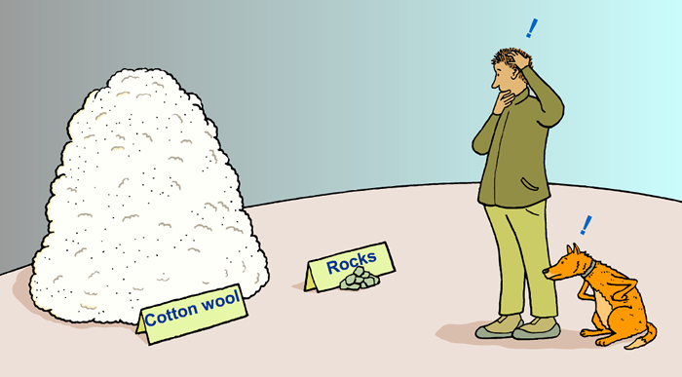

Compound measures
Which is heavier: a kilogram of cotton wool or a kilogram of rocks?

Slide 3
Compound measures
Of course, a kilogram of rocks weighs the same as a kilogram of cotton wool – they both weigh one kilogram!
If you thought that the rocks were heavier, you were probably thinking of their density rather than their weight.
Density is an example of a compound measure.
It is a measure of the mass of an object per unit volume.
Density is usually measured in g/cm³ or kg/m³. It can also be measured in kg/l.
A density of 1.2 g/cm³ means that every 1 cm³ of the material has a mass of 1.2 grams.
Notes:
Explain that the ‘/’ in g/cm³ is read as ‘per’ and means ‘for every’ or ‘in every’.

Slide 4
Compound measures
Which is heavier: 1 cm³ of cotton wool or 1 cm³ of rock?
This is a more sensible question. Rock is denser than cotton wool and so 1 cm³ of rock is heavier than 1 cm³ of cotton wool.
We can find the density of a given material using the following formula:
mass
Density =
volume
For example, if a block of metal has a mass of 760 g and a volume of 80 cm³ :
760
Density =
=
9.5 g/cm³
80

Slide 5
Compound measures
We use compound measures when we are comparing how one measurement changes with another.
When one measurement changes in direct proportion with another it is said to change at a constant rate.
For example, suppose a man is running around a race track.
The total distance he has run changes with time.
The rate at which he runs is called his speed.
distance travelled
Speed =
time taken
Speed is usually measured in km/h, m/s or mph.
Notes:
When we use this formula we assume that the person or object is travelling at constant speed.

Slide 6
Average speed
In many situations the speed is not constant.
For example, the man running around the track will probably speed up or slow down as he runs.
We can still calculate his average speed using the following formula:
total distance travelled
Average speed =
total time taken
For example, if the man runs 1560 metres in 300 seconds
1560
Average speed =
= 5.2 m/s
300

Slide 7
Common compound measures
Commonly used compound measures include:
Density
mass
Measured in g/cm³, kg/m³ or kg/l .
volume
Speed
distance
Measured in m/s, km/h or mph .
time
Pressure
force
Measured in N/m² or N/cm² .
surface area
Fuel consumption
distance
Measured in km/l or mpg .
volume
Notes:
Give examples where necessary. For example, the fuel consumption of a car depends on how much petrol it uses over a given distance.
Discuss the equivalent formulae for each one. For example, If density is mass divided by volume, then mass is density times volume and volume is mass divided by density.

Slide 8
Converting compound units
What is 45 mph in m/s?
When we convert compound unit we usually have to do it in several steps, especially if both units are being changed.
45 mph stands for 45 miles per hour.
We have to change the 45 miles into metres and 1 hour into seconds.
5 miles = 8 km
So 1 mile = 1.6 km
45 miles ≈ 45 × 1.6 km
= 72 km
= 72 000 m
1 hour = 60 minutes
= 3600 seconds
Notes:
Explain that because we are converting between metric and imperial units the conversion is approximate.

Slide 9
Converting compound units
What is 45 mph in m/s?
Travelling 45 miles in 1 hour is equivalent to travelling 72 000 m in 3600 seconds.
72 000
Therefore, 45 mph ≈
m/s
3600
= 20 m/s
How could we use this answer to convert any speed given in mph to a speed in m/s?
45 mph ≈ 20 m/s
Dividing by 5 we have, 9 mph ≈ 4 m/s
We can divide the speed in mph by 9 and multiply it by 4.
Notes:
Explain that because we are converting between metric and imperial units the conversion is approximate.
Pupils do not need to know how to convert between mph and m/s using 9 mph = 4 m/s. However, it is interesting to see how this conversion is derived.
Ask pupils how we could convert m/s to mph using the same conversion (divide by 4 and multiply by 9).
Link this to work on proportion.

